Slide 1
Grainger - End of Tenancy
SteerCo Update
5th December 2023

Slide 2
Project Summary
Milestones
Risks and Issues
Forecast and Budget
Next Steps

Slide 3
Project Summary
Sprint 4 was completed on 1st December.
Go-live is planned for 15th January 2024.
September 2023 October 2023 November 2023 December 2023 Jan 2024
Sprint 1
UAT
Sprint 2
UAT
Sprint 3
UAT
Sprint 4
UAT
We are here
December break
Grainger code freeze
Go Live

Slide 4






Project Summary... continued
We followed an agile methodology. Touch points each week included:
- 2 Standups
- 1 Refinement Session.
Grainger stakeholders were highly responsive, and the project team as a whole worked very well together.
Open Box Delivery Team
GRAINGER Delivery Team
4
Salesforce Architect
- Sam
Business Analyst
- Nikki
Developers
- Matthew, Dillan, Anjali, Avi, Sachin
Quality Assurance
- Khonani
Project Manager
- Shaun
Product Owner
- Jacob
Sprints
Project Sponsor
- Jon
10
Project Manager
- Yvonne
Additional User Stories
1
Subject Matter Experts
- Anita, Mike
UAT Bugs Logged

Slide 5
Delivery Breakdown
Sprint | Backlog Points | UAT Feedback | Additional Items | Total
1 | 61 | 0 | 0 | 61
2 | 76 | 3 | 0 | 79
3 | 35 | 16 | 7 | 58
4 | 48 | 10 | 19 | 77
Total | 220 | 29 | 26 | 275
Sprint 1 Burn Down

Slide 6
Milestones… continued
Project Objectives per the Statement of Work | Status
Enable users to create & complete an end-to-end void workflow | Completed
Automatically calculate & revise estimated void timelines | Completed
Enable users to upload void-related documents to Salesforce | Completed
Audit history | Completed
Automatically update Salesforce units with void-related information | Completed
Provide a view of voids for a unit & building | Completed
Replace internal notification emails with tasks & dashboards | Completed
Provide a view of task lists for users and teams | Completed
Display a property calendar of onsite void tasks | Completed
Display a dashboard of KPIs & voids behind schedule | Completed

Slide 7
Risks & Issues
Risk | Impact | Probability | Mitigation
Change management plan | Low | Low | Open Box delivering a User Guide.
No support agreement in place | Med | Med | Open Box to work with Grainger to assess what options are feasible.
Issue | Impact | Status
None | NA | NA

Slide 8
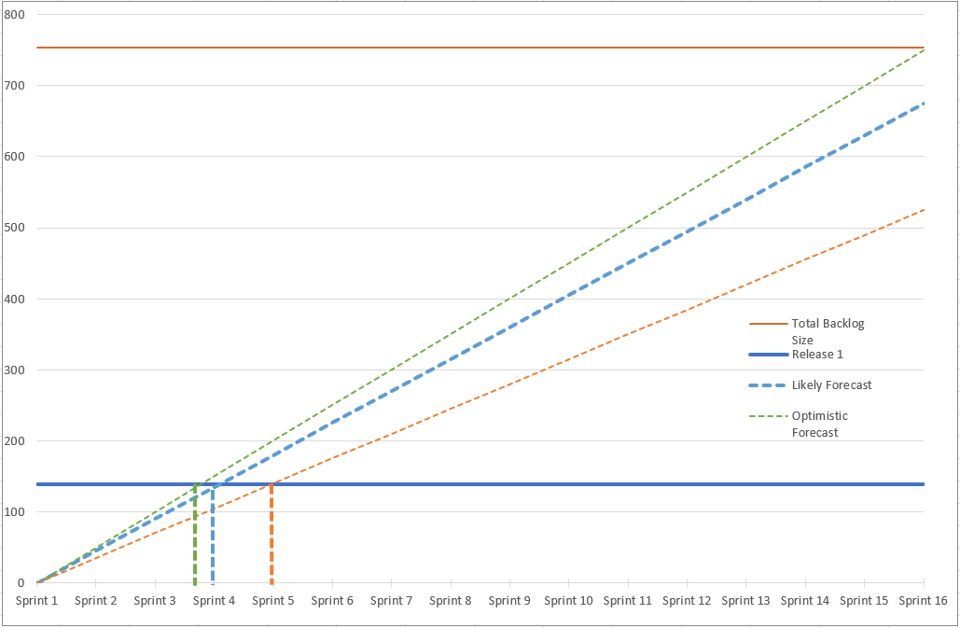
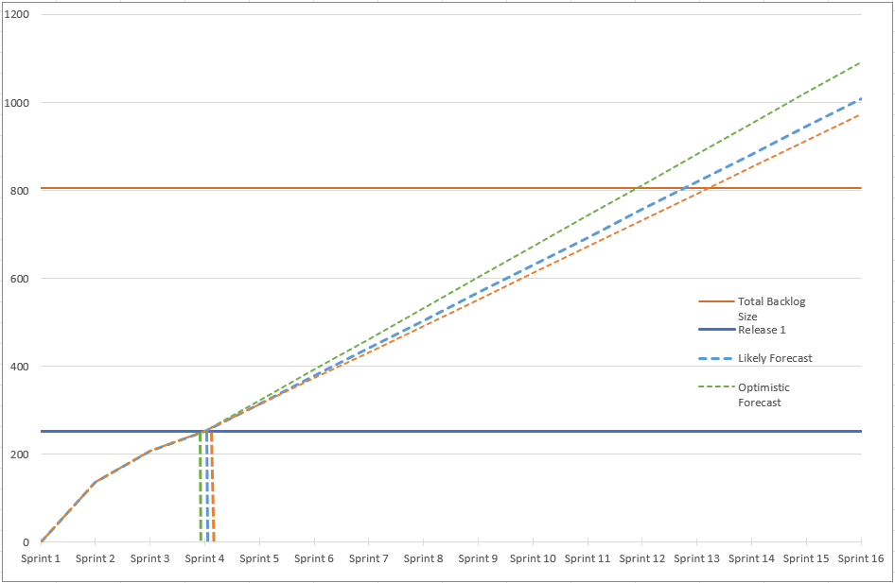
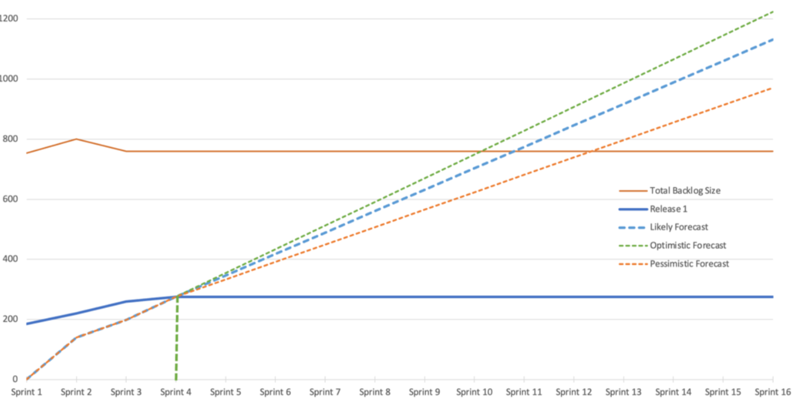
Forecast
Pre-delivery
Current View
754
806
Backlog
Backlog
185
275
Story Points
Story Points
4 - 5
4
Sprints
Sprints
Forecast at start of project
Forecast after sprint 2
Forecast after sprint 4

Slide 9


Budget
The project is currently on budget. We anticipate closing out the project without any additional costs
The billing milestones are as follows:
  £ 35,100 was billed on 1st Oct
  £ 35,100 was billed on 1st Nov
  £ 70,200 was billed on 1st Dec
  £ 3,600 to be billed 1st Jan (UAT)
  £ 3,600 to be billed 1st Feb (Prod support)
We will continue to monitor and manage project costs closely.
Billing
Billing per Sprint
£147,600
4 of 4
Sprints invoiced

Slide 10
Next Steps
Open Box to deliver the User Guide to facilitate Grainger’s Change Management process
Close out UAT by 15th Dec
Confirm go-live cutover actions
Go-live on 15th Jan
FTE support
Release 2
  Mobile app for onsite operations
  New workflows – e.g. Early vacation, Garage/Parking Bay
  Capture wishlist for refurb/refresh
  Replace FSI PVI checklist
  Move Out & PVI confirmation emails to tenants

Slide 11
Thank You

